Slide 1
BLIS KENYA

Slide 2
INTRODUCTION
BLIS (Basic Laboratory Information System) Kenya, is a fork of C4G BLIS an open source Web-based system that can be implemented in a local, district, or national laboratory.
The system efficiently manages the work flow in the lab through integrating with the hospital EMR's, automatically receiving lab test requests from the clinicians/doctors and returning the results.
The system tracks the movement of specimens providing respective turn-around-times for tests, and provides individual workload monitoring, test reporting and quality control.

Slide 3
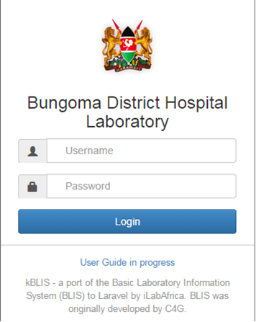
Getting Started with BLIS
To start the Basic Laboratory Information System, you must click on the bookmark saved on the web browser e.g. Google Chrome or Mozilla Firefox. You will then see a page requesting login information. You must then enter your credentials to proceed.
If you have forgotten your password, kindly contact the lab-in-charge for help.

Slide 4
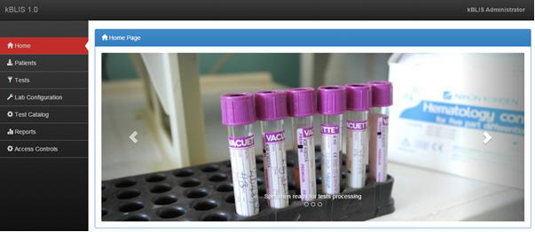
Continuation….
On successful sign-in, you should see such a page as this. The highlighted section shows the person signed in.

Slide 5
LAB CONFIGURATION
The lab configuration section allows you to change how reports are generated, load drivers and define equipment for instrumentation, what patient data is collected, referral facilities, as well as various other settings.
The various pages of this section are explained in the following slides:

Slide 6
Conceptualization
Can BLIS fetch results from different analyzers of the same type? e.g. CELTAC1 in Ward 1 and CELTAC2 in Ward 2.
Yes! That's why we have 2 buttons.
is for adding the driver (common to all machines of the same type).
is for specifying the physical location of the machine.

Slide 7
Implementation
BLIS interfaces with the connected equipment courtesy of a class file that extends theAbstractInstrumentor class which in turn implements the InstrumentorInterface. A sample file is provided (CeltacWBC.php) showing the format in which BLIS expects the result of the getResult() method.
On importation, plugin files a copied to the app/kblis/plugins/ directory. From there, they can be loaded into the application via psr-4.

Slide 8

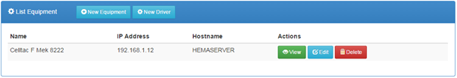
Instrumentation user interface
This can be accessed from the link, then click the sub menu on the navigation menu.
The default page shows a list of all Equipment already configured for use.

Slide 9
Configuring Equipment Drivers
Driver files tell kBLIS how to access test information from analyzers. A driver implementation should publish following information:
the equipment name
a unique identification code
a description of the equipment
the medical tests it can perform.
To import a driver file,
Click on the button on the Equipment List page.
In the dialog box that appears, click the or button to open a files dialog box

Slide 10
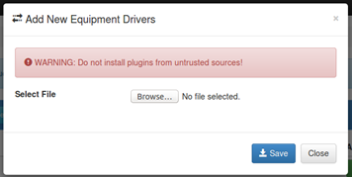
Continuation….

Slide 11
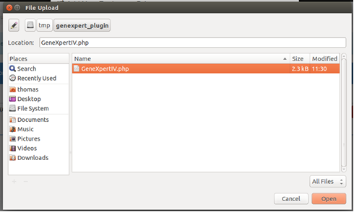
Continuation….
Select a driver file

Slide 12
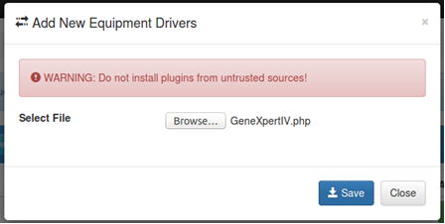
Continuation….
iv. Save the driver file.

Slide 13
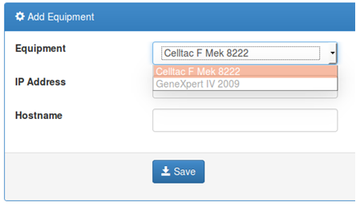
Continuation….
The new driver will now be listed as one of the available drivers.

Slide 14

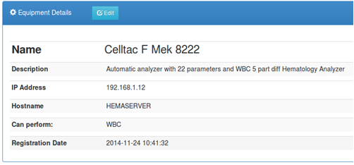
View Equipment Details
Clicking the button displays the details of the listed equipment

Slide 15

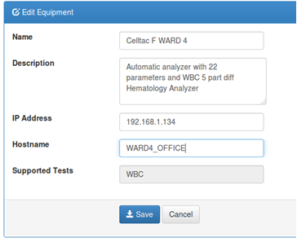
Update Equipment Details
The button allows for changing the details of the listed equipment including:
name
description
ip address
host name

Slide 16
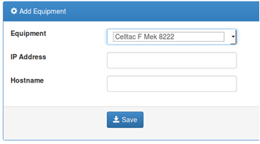
Adding A New Equipment
In this step, the user defines the location of a particular machine by specifying the IP address and optionally the hostname to which the machine is attached.
1. The process is initiated by clicking on from the Equipment List page.
2. Click the button to save the details.

Slide 17

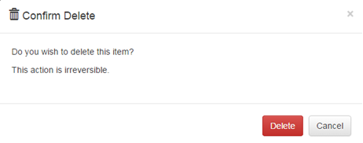

Deleting Existing Equipment
1. Click the button on the equipment list page for corresponding equipment
2. Click the button on the pop-up if you are sure to delete, otherwise, click the button or icon to dismiss.

Slide 18
Facilities
Allows for the definition of other health facilities which do referrals to the lab or we refer tests to. Most are satellite facilities.

Slide 19
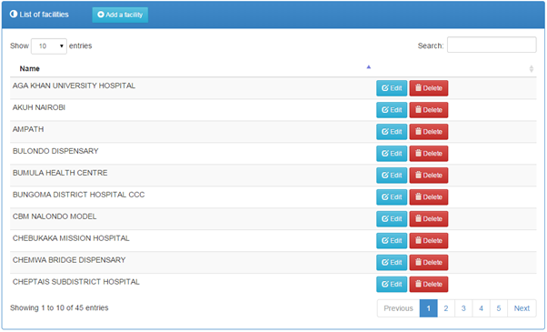
Listing Existing Facilities
1. Click the link on the navigation menu.
2. The list of facilities will be loaded as shown below.

Slide 20

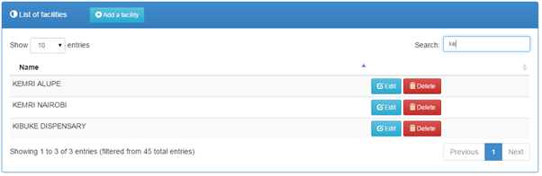
Searching for a Facility
1. Begin typing the name of the facility in the search filed provided
2. The list will automatically be loaded with matching values e.g.

Slide 21
Adding a new Facility
1. Click the button to load the new facility details form.
2. Complete the form as appropriate.
3. Click the button to save the details.

Slide 22
Updating a Faculty’s Details
1. Click the button of the corresponding record to open a form with pre-filled values.
2. Make the necessary modifications to the details presented.
3. Click the button to save the details.

Slide 23

Deleting a Faculty
1. From the list of facilities, click the button of the corresponding record
2. Click the button on the pop-up if you are sure to delete, otherwise, click the button or icon to dismiss.

Slide 24
Surveillance
Allows for the definition of the different test parameters for a particular disease available in the system and adding new diseases.

Slide 25
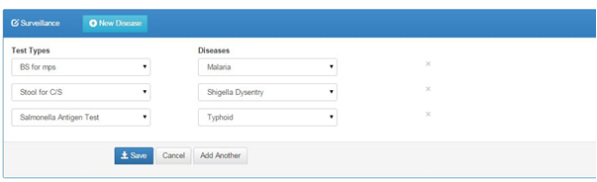
Listing Existing Surveillances
1. Click the link on the navigation menu.
2. The list of tests and diseases will be loaded as shown below.

Slide 26
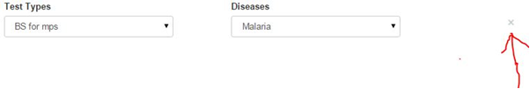
Removing a Test and its Disease
Click the X button as shown below

Slide 27

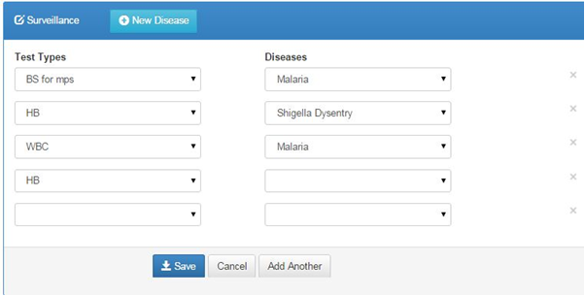
Adding new configuration, new test and Disease for Surveillance
1. Click the button to load drop down combo boxes where you will be able to select test and disease alongside one another.
2. Complete the form as appropriate.
3. Click the button to save the details.

Slide 28

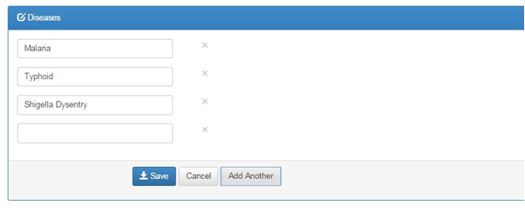
Adding new Disease for the Surveillance
1. Click the button to load a text field.
2. Complete the field as appropriate.
3. Click the button to save the details

Slide 29

Removing a Disease
Click the X button as shown below

Slide 30
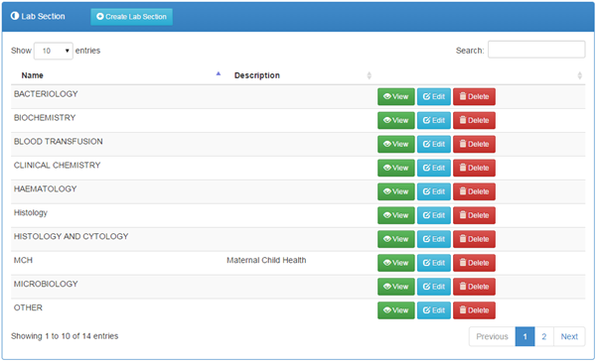
Lab Sections
To list all lab sections;
1. Click the link on the navigation bar
2. The lab sections will be loaded

Slide 31
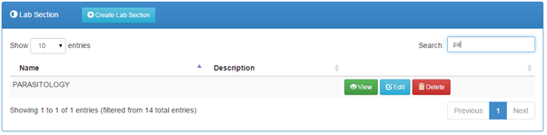
Searching for a Lab Section
1. Simply type the name of the lab section on the search field
2. The list will automatically be loaded with matching values e.g.

Slide 32
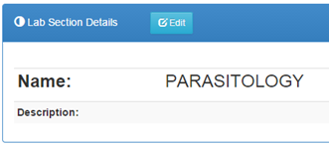
Viewing a Lab Section
1. Click the button of the corresponding record.
2. The details shall be loaded on to a panel e.g

Slide 33
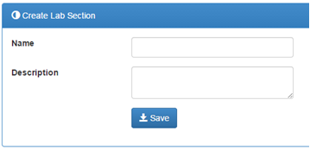
Adding a new Lab Section
1. On the list of lab sections, click the button.
2. Complete the details on the provided form
3. Click the button to save the lab section to the system

Slide 34
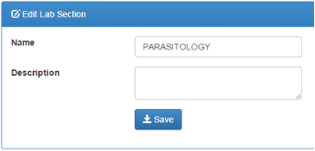
Updating a Lab Section
1. Click the button of the corresponding record to open a form with pre- filled values
2. Make the necessary modifications
3. Click the button to save the changes

Slide 35
Deleting a Lab Section
1. Click the button of the corresponding record.
2. Click the button on the pop-up if you are sure to delete, otherwise, click the button or icon to dismiss.

Slide 36
Specimen Types
Allows you to set the specimen types as appropriate for your laboratory.

Slide 37
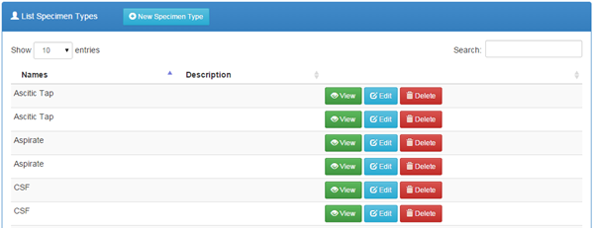
Listing available Specimen Types
1. Click the link on the navigation menu.
2. A list of available specimen types will be loaded

Slide 38
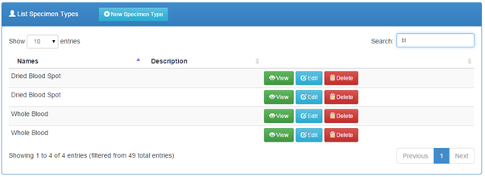
Searching for a Specimen Type
1. Start typing the specimen type on the search field
2. The list will automatically be loaded with matching values e.g.

Slide 39
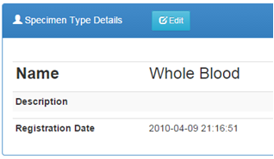
Viewing a Specimen Type
1. Click the button of the corresponding specimen type.
2. The details shall be loaded on to a panel e.g.

Slide 40
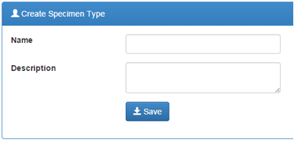
Adding a new Specimen Type
1. On the list of specimen types, click the button.
2. Complete the details on the provided form
3. Click the button to save the specimen type to the system

Slide 41
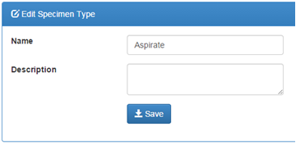
Updating a Specimen Type
1. Click the button of the corresponding record to open a form with pre-filled values
2. Make the necessary modifications
3. Click the button to save the changes

Slide 42
Deleting a Specimen Type
1. Click the button of the corresponding record.
2. Click the button on the pop-up if you are sure to delete, otherwise, click the button or icon to dismiss.

Slide 43
Specimen Rejection
Allows for definition of the various reasons for specimen rejection as applicable to the laboratory

Slide 44
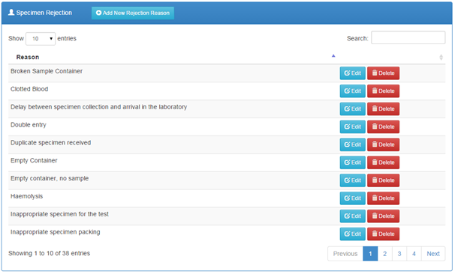
Listing all Specimen Rejection Reasons
1. Click the link on the navigation menu.
2. The list of specimen rejection reasons appears in a panel as shown.

Slide 45
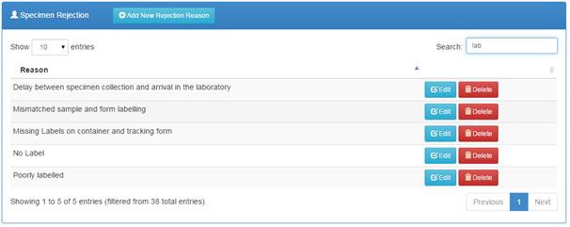
Searching for a Specimen Type
1. Begin typing the rejection reason on the search field
2. The list will automatically be loaded with matching values e.g.

Slide 46
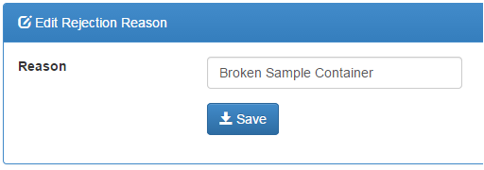
Adding a new Rejection Reason
1. Click the button of the corresponding record to open a form with pre-filled values.
2. Make the necessary modifications
3. Click the button to save the changes

Slide 47
Deleting a Rejection Reason
1. Click the button of the corresponding record.
2. Click the button on the pop-up if you are sure to delete, otherwise, click the button or icon to dismiss.

Slide 48
Test Types
Allows you to set the specimen types as appropriate for your laboratory.

Slide 49
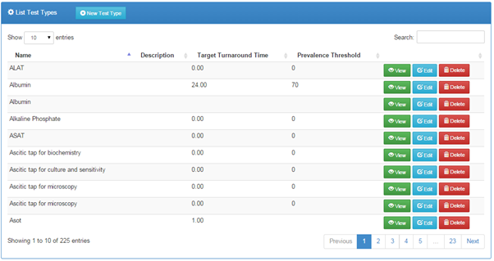
Listing all Test Types
1. Click the link on the navigation bar

Slide 50
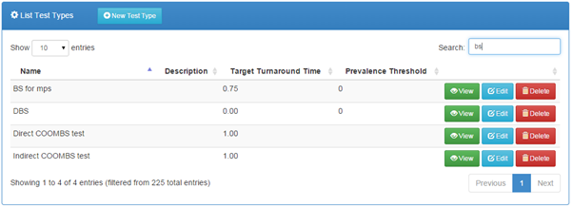
Searching for a Test Type
1. Begin typing the test type name on the search field
2. The list will automatically be loaded with matching values e.g.

Slide 51
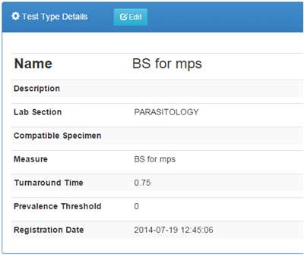
Viewing a Test Type
1. Click the button of the specific test type
2. The details shall be loaded on to a panel e.g.

Slide 52
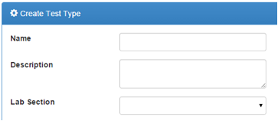
Adding a New Test Type
1. On the list of test types, click the button.
2. Complete the details on the provided form

Slide 53
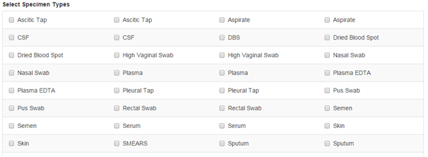
Continuation….
3. Select the applicable specimen types

Slide 54

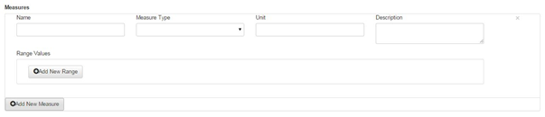
Continuation….
4. Add the applicable measures for the test type by clicking which will populate the form below

Slide 55

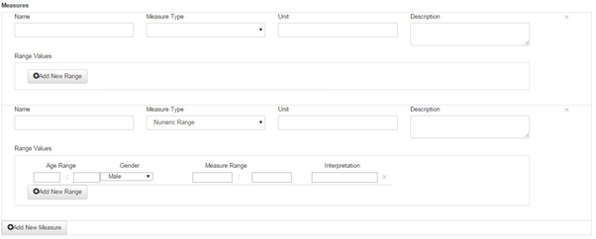
Continuation….
5. Add applicable range for the measure by clicking which will populate the form below

Slide 56
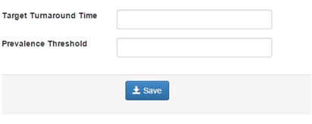
Continuation….
6. Complete the details such as expected turnaround time

Slide 57
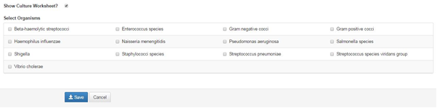
Continuation….
7. Check the show culture worksheet button to select the organisms as shown below
8. Click the button to save the specimen type to the system

Slide 58
Updating Test Type Details
1. Click the button to open a form with pre-filled values.
2. Make the necessary modifications such as the lab section, specimen types, measures and so forth.
3. During editing, Culture worksheet can be shown by checking the box . After the box has been checked the following details will be added in the test type editing interface as shown below where you will able to select the organisms.

Slide 59
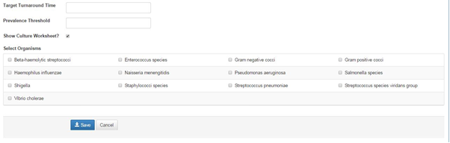
Continuation….
4. Click the button to save the changes.

Slide 60

Deleting a Test Type
1. Click the button of an entry
2. Click the button on the pop-up if you are sure to delete, otherwise, click the button or icon to dismiss.

Slide 61
Drugs
Allows you to create drugs as appropriate for your laboratory.

Slide 62
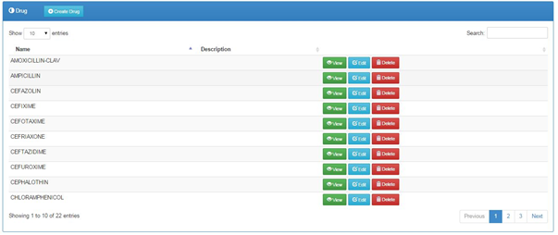
Listing all Added Drugs
1. Click the link on the navigation bar

Slide 63
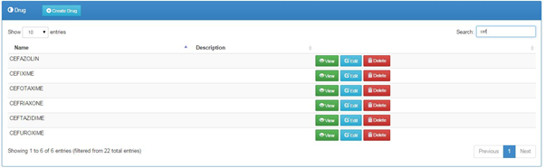
Searching for a Drug
1. Begin typing the drug name on the search field
2. The list will automatically be loaded with matching values e.g

Slide 64

Viewing a Drug
1. Click the button of the specific test type
2. The details shall be loaded on to a panel e.g

Slide 65

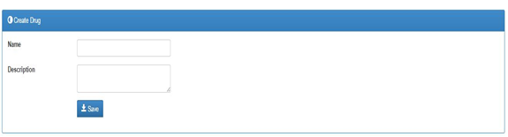
Adding a new Drug
1. On the list of drugs, click the button.
2. Complete the details on the provided form
3. Click the button to save the drug to the system

Slide 66
Updating Drug Details
1. Click the button to open a form with pre-filled values.
2. Make the necessary modifications such as the drug name, description and so forth.
3. Click the button to save the changes.

Slide 67

Deleting a Drug
1. Click the button of an entry
2. Click the button on the pop-up if you are sure to delete, otherwise, click the button or icon to dismiss.

Slide 68
Organisms
Allows you to create drugs as appropriate for your laboratory.

Slide 69
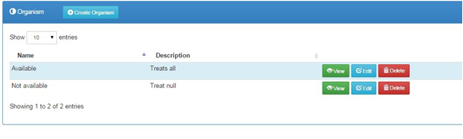
Listing all Organisms
1. Click the link on the navigation bar

Slide 70
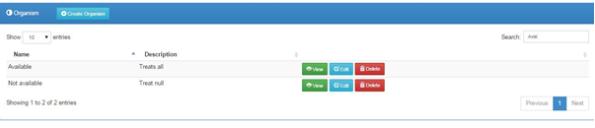
Searching for an Organism
1. Begin typing the organism name on the search field
2. The list will automatically be loaded with matching values e.g.

Slide 71
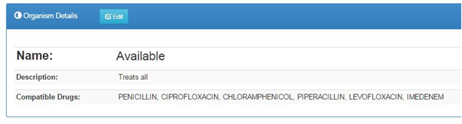
Viewing an Organism
1. Click the button of the specific test type
2. The details shall be loaded on to a panel e.g.

Slide 72

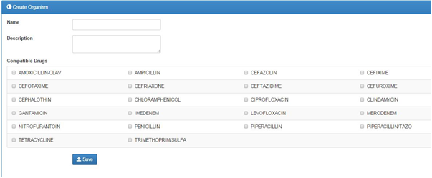
Adding a new Organism
1. On the list of drugs, click the button.
2. Complete the details on the provided form

Slide 73
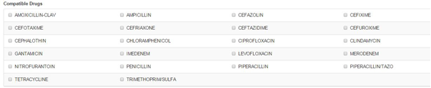
Continuation….
3. Select the applicable compatible drugs
4. Click the button to save the organism to the system

Slide 74
Updating Organism Details
1. Click the button to open a form with pre-filled values.
2. Make the necessary modifications such as the organism name, description, compatible drugs and so forth.
3. Click the button to save the changes.

Slide 75

Deleting an Organism
1. Click the button of an entry
2. Click the button on the pop-up if you are sure to delete, otherwise, click the button or icon to dismiss.

Slide 76
Reports
The Patient Report and Daily Log should be run every day.

Slide 77

Patient Reports
1. Click the link on the Reports sub-menu to open the patients reports listing
2. Search for the patient by Patient Name, Patient Number, or Patient ID.
3. Click the button to start search.
4. Select the patient you want from the list if more than one patient matches your search criteria.
5. Click to see all data for that patient.
6. Click to filter the report and to export to word document.

Slide 78
Daily Log
1. Click the sub-menu under reports to view daily logs.
2. Set the date range to reflect the log to print. You can run a report of the day’s activity by patients seen (by clicking Patient Records), or by tests run (by clicking Test Records) or rejected specimens (by clicking Rejected Specimen Records).

Slide 79
Test Records
You can choose to run a log for one lab section or for one type of test, for all tests or pending tests only. The default settings are test records, all sections, and all tests. The report loads with Export controls at the top of the page.

Slide 80

Patient Records
1. Click on the checkbox
2. Apply the filter parameters, date ranges in this case
3. Click the button to load the report
4. Click the button to toggle the summary
5. Click the button to export the report to word document for further processing

Slide 81
Rejected Specimen Records
1. Click the checkbox then button to load the report
You can choose to run a log for one lab section or for one type of test. The default settings are test records, all sections, and all tests. The report loads with Export controls at the top of the page

Slide 82
Aggregate Reports
These are accrued summaries over a period of time.

Slide 83

Prevalence Rates
Gives the prevalence of a particular laboratory test result based on the number of tests done and the results.
1. Click the sub-menu to load the report.
By default, the report loads prevalence rates for the current year
2. Click the button to load the report with the filters you defined
3. You can view a numeric summary of the prevalence rates by clicking the button to reveal the numeric data.
4. You can click on a test on the legend section to hide its graph

Slide 84
Counts Reports
Generates a report for a particular time period of the number of tests and specimens both grouped and ungrouped.
1. Click the sub-menu to launch the counts reports options

Slide 85
Test Counts(ungrouped)
Shows for each test, the number of complete vs pending tests
The report can be filtered by specifying date ranges then clicking the button to load the report with the applied filters.

Slide 86
Test Counts (grouped)
This is a report that groups tests according to various parameters such as lab section, gender, age ranges then counts the numbers for each while showing the total tests run.
Click the checkbox then to load the report

Slide 87
Specimen counts (Ungrouped)
It is a count for accepted vs rejected specimen
Click the then to load the report

Slide 88
Specimen counts (grouped)
Click the checkbox then to load the report

Slide 89
Turnaround time report
Allows you to see actual turnaround times between test order and completion for all or specific tests.
1. Click the sub-menu to load the report
2. Set a date range then click the button to filter the report. The default is data for the current year.
3. You can choose to run a log for one lab section or for one type of test. The default settings are test records, all sections, and all tests.
4. The report loads with Export controls which can be accessed by clicking the icon where the chart can be exported to PDF document or as an image.

Slide 90
Infection Report
Allows you to generate reports of infections by patient age and gender.
1. Click sub-menu to load the report. By default, it loads data counts for the current year.
2. Set a date range or select one Lab Section, or all sections to see all test results after clicking the button.

Slide 91
User Statistics Report
Display user specific statistics and user activity logs.
To load the report, click the link on the navigation menu.
The report can be filtered by date ranges, a specific user and report type such as patient registry, specimen registry and so forth. The default report type is the general summary as shown above.
To filter, change the parameters as desired then click the button.
You can also search for a certain user using the
The list of users will automatically filtered as you type.

Slide 92
Surveillance Reports
Allows you to generate surveillance report by laboratory and test outcome.
1. Click sub-menu to load the report. By default, it loads surveillance for the current month.
2. Set a date range to see all test results after clicking the button.

Slide 93
Quality Control Report
Allows you to generate quality control report by range and control type.
1. Click sub-menu to load the report. By default, it loads quality control report for the current month.
2. Set a date range and select the control type to see all results after clicking the button.

Slide 94
Inventory Reports
These are accrued summaries of inventory over a period of time.

Slide 95
Stock Level Reports
Gives a brief summary of the available stock.
1. Click the sub-menu to load the report.
By default, the report loads stock levels for the current month
2. Set a date range to view report either monthly or quarterly. Click the button to load the report with the filters you defined

Slide 96
Access Controls
User Accounts
This page shows all the users with access to the system. It allows you to create new user accounts, edit account settings, delete accounts, and monitor account activity.

Slide 97
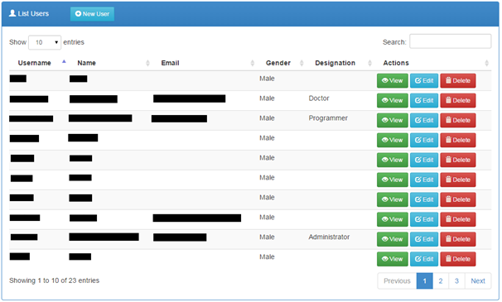
List Users
Click the link on the navigation menu.

Slide 98
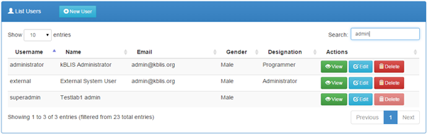
Searching a User
1. Begin typing a user’s name, username or email in the search field
2. The list shall be automatically filtered

Slide 99

Viewing a User’s Details
1. Click the button to load the measure details
2. The user details shall be loaded on to a panel

Slide 100

Adding a new User
1. Click the button to load a new user account form
2. Complete the form with the user’s details
3. Click the button to save the changes.

Slide 101
Updating a User’s Details
1. Click the button on the users list.
2. Make the desired modifications to the pre-filled details
3. Click the button to save the changes.

Slide 102

Deleting a User
1. To delete, click the button.
2. Click the button on the pop-up if you are sure to delete, otherwise, click the button or icon to dismiss.

Slide 103
Permissions
This is where each role in the system is assigned specific actions enabled for that role

Slide 104

List all Permissions
1. Click the link on the navigation menu.
2. The list of all permissions is as shown

Slide 105
Defining and Updating Privileges
1. Check all permissions a role can be allowed to handle as designed by the lab as shown above.
2. Click the button to save the changes.

Slide 106

Roles
Listing Roles
1. Click the link on the navigation menu
2. The list of available roles shall be loaded

Slide 107
Adding a new Role
1. Click the button
2. Complete the presented form
3. Click the button to save the changes

Slide 108
Updating an Existing Role
1. Click the button
2. Make the necessary modifications to the data
3. Click the button to save the changes.

Slide 109

Deleting a Role
1. To delete click the button
2. Click the button on the pop-up if you are sure to delete, otherwise, click the button or icon to dismiss.

Slide 110
Assign Roles
Allows the assignment of specific roles to the various users of the system.

Slide 111

Assigning and Updating Assigned Roles to Users
1. Click the link on the navigation bar.
2. On the loaded panel, check as appropriate to the user and role
3. Click the button to save the changes.

Slide 112
Inventory
Suppliers
Allows you to add a suppliers to the commodity system

Slide 113

Listing all Suppliers
1. Click the link on the navigation bar

Slide 114

Searching for a Supplier
1. Begin typing the supplier name on the search field
2. The list will automatically be loaded with matching values e.g.

Slide 115


Adding a new Supplier
1. On the list of suppliers, click the button.
2. Complete the details on the provided form
3. Click the button to save the supplier to the system

Slide 116
Updating a Supplier Details
1. Click the button to open a form with pre-filled values.
2. Make the necessary modifications such as the name, phone no, item email and so forth.
3. Click the button to save the changes.

Slide 117
Deleting a Supplier
1. Click the button of an entry
2. Click the button on the pop-up if you are sure to delete, otherwise, click the button or icon to dismiss.

Slide 118
Quality Controls
Allows you to manage the quality control system

Slide 119

Listing all Controls
1. Click the link on the navigation bar

Slide 120

Searching for a Control
1. Begin typing the control name on the search field
2. The list will automatically be loaded with matching values e.g.

Slide 121



Control Results
1. Click the link on the navigation bar to list all control results.
2. To enter control results click . After entering the results save as required.

Slide 122


Controls
To add a new control;
1. On the list of controls, click the button.
2. Complete the details on the provided form

Slide 123


Continuation….
3. To add a new measure click and the form below will be displayed, fill and select all necessary fields. You can also add measure range by clicking the add new range button
4. Click the button to save the control to the system

Slide 124
Lots
Allows you to add a lots to the qc system

Slide 125

Listing all Lots
1. Click the link on the navigation bar

Slide 126

Searching for a Lot
1. Begin typing the lot name on the search field
2. The list will automatically be loaded with matching values e.g

Slide 127


Adding a new Lot
1. On the list of lots, click the button.
2. Complete the details on the provided form
3. Click the button to save the lot to the system

